Slide 1
December’s Newsletter
Welcome to December! We have a few exciting things going on this month. In this newsletter we will go over upcoming events, student of the month for October, and December’s birthdays. As we get closer to the holidays let’s remember to bundle up for the cooler weather and remember to wash your hands!

Slide 2
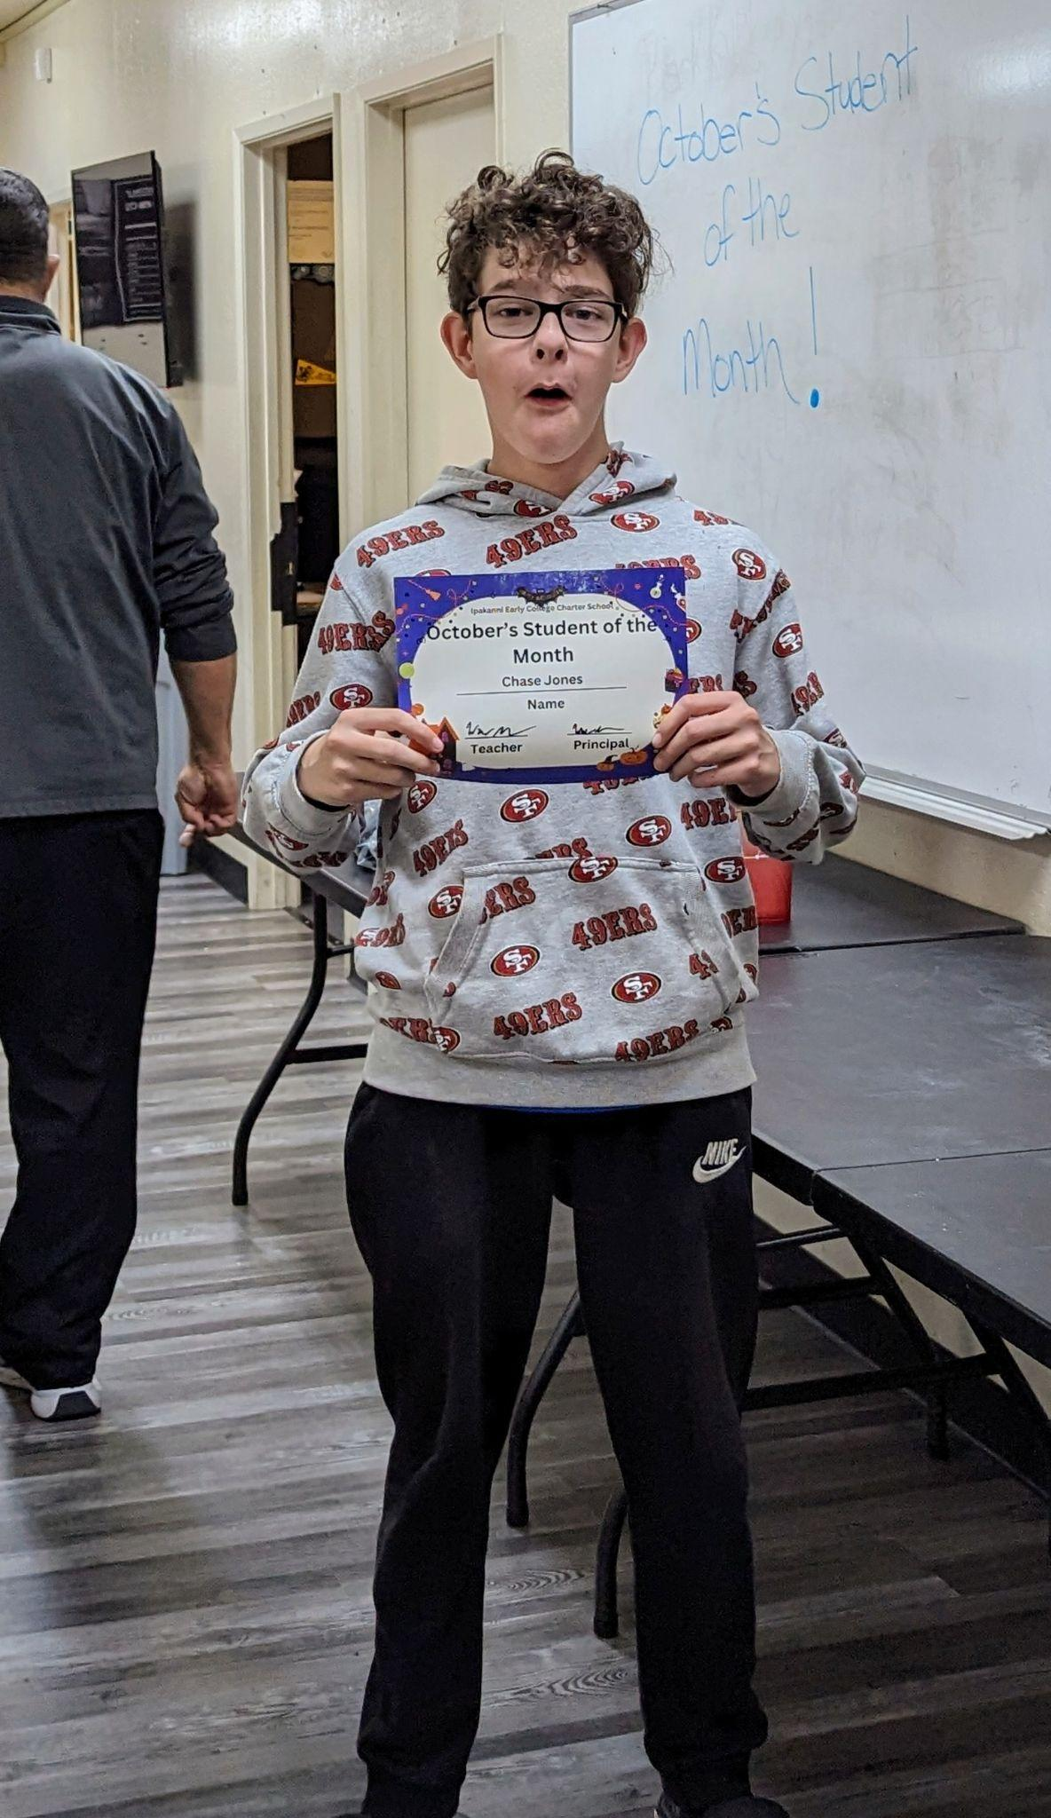
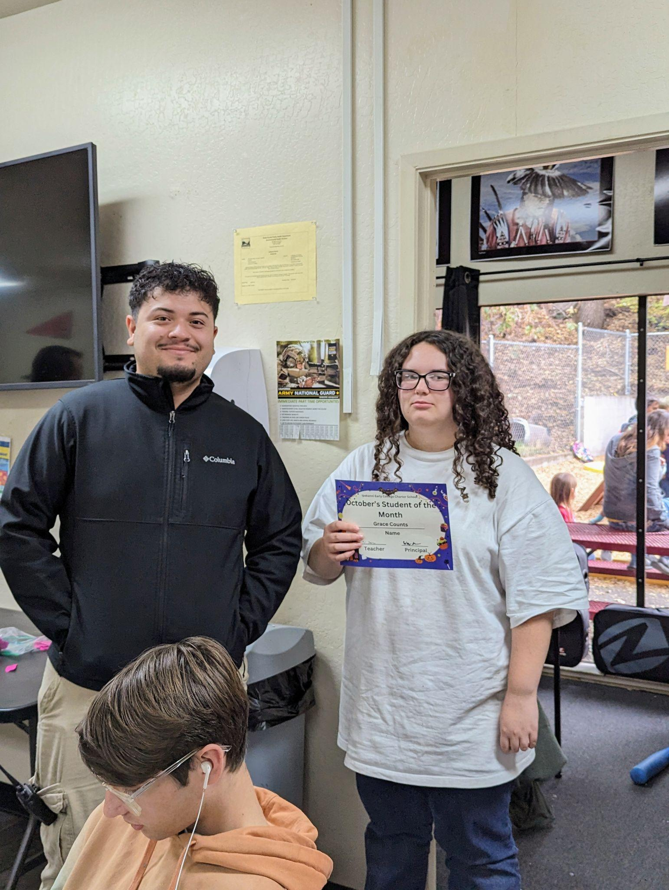
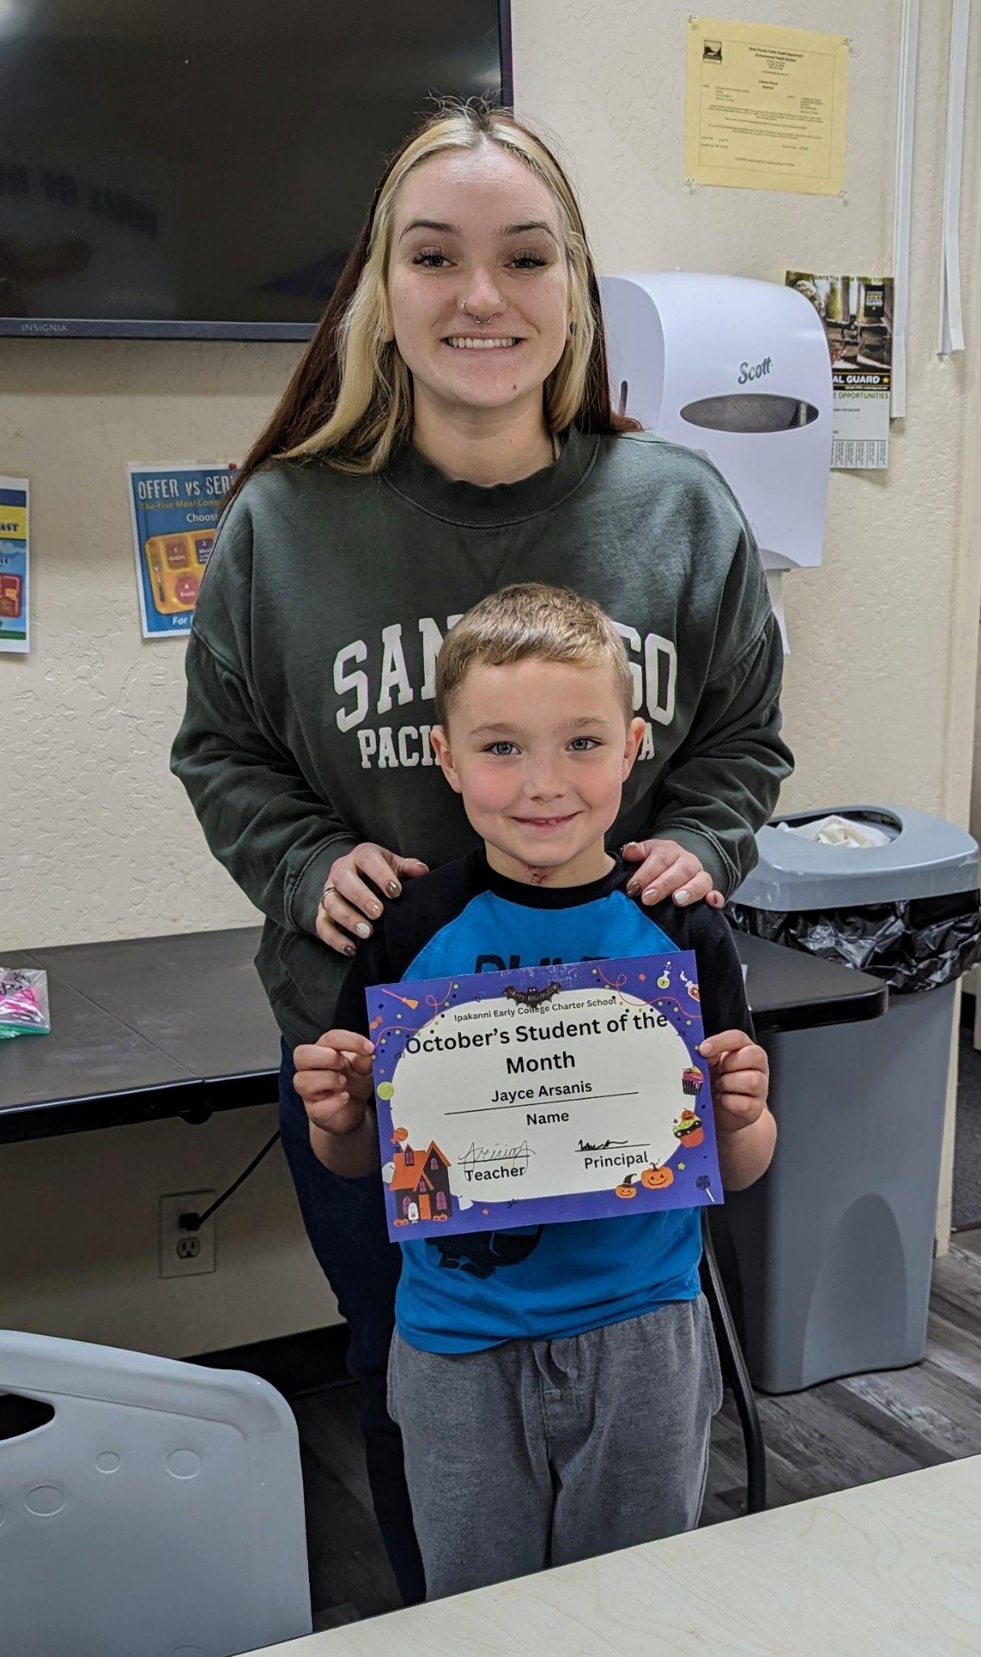
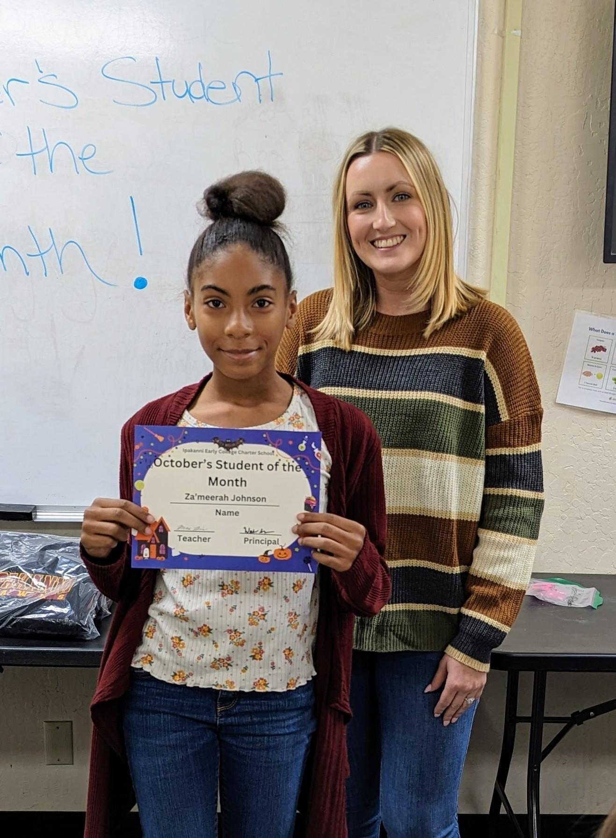
Student of the Month for October!
Jayce Arsanis
Za’meerah Johnson
Grace Counts
Chase Jones

Slide 3
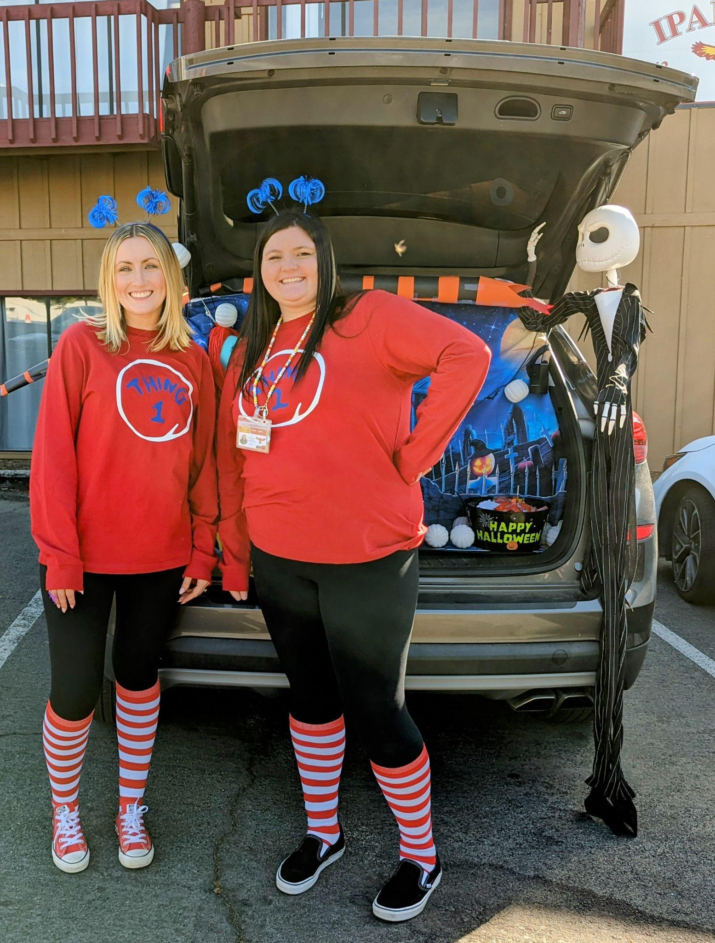
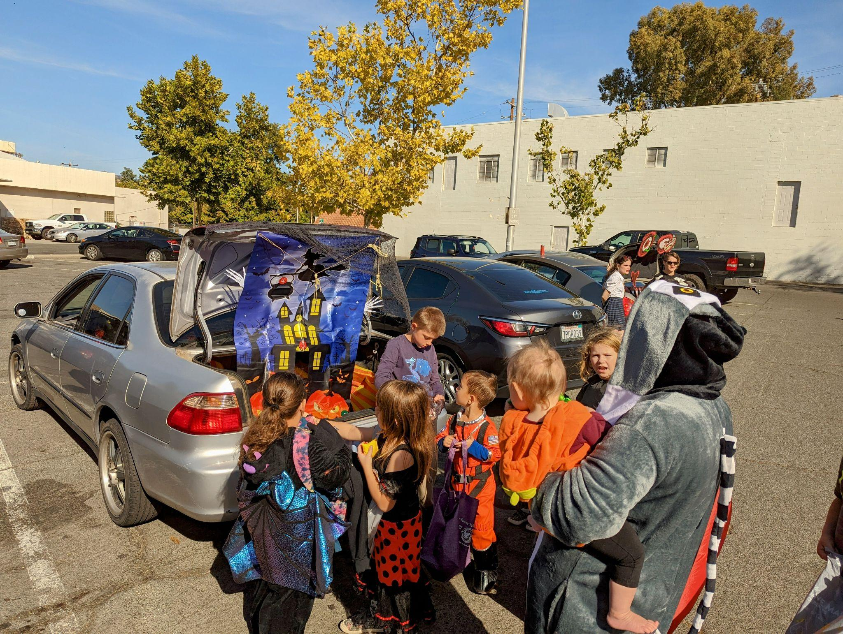
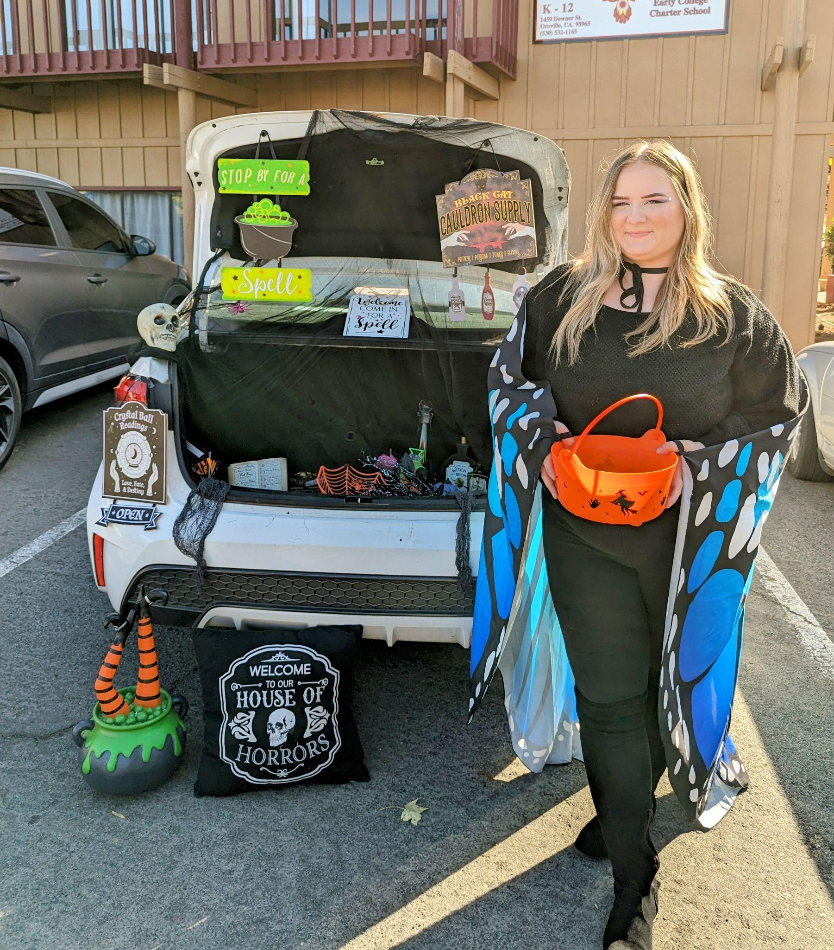
TRUNK and Treat
We had our annual Trunk and Treat on October 31st and we would like to give a HUGE thank you to everyone who participated! It was so exciting to see all the different decorations!

Slide 4
September Birthdays!
We want to wish the following students a very Happy Birthday!
Terryon Spivey December 4th
Brook Virden December 8th
JJ Rasmussen December 9th
Jason Nelson December 14th

Slide 5
Mark your Calendars!
December 14 - Christmas party! @ 5pm-6:30 pm
December 20th- Semester report cards and minimum day
December 21st- Jan 2nd- Winter Break

