Slide 1
January Newsletter
Happy New Year! We hope everyone is having a restful winter break! In this letter we will be going over Student of the Month from November, the Holiday Party we had before winter break, January birthdays and upcoming events.

Slide 2
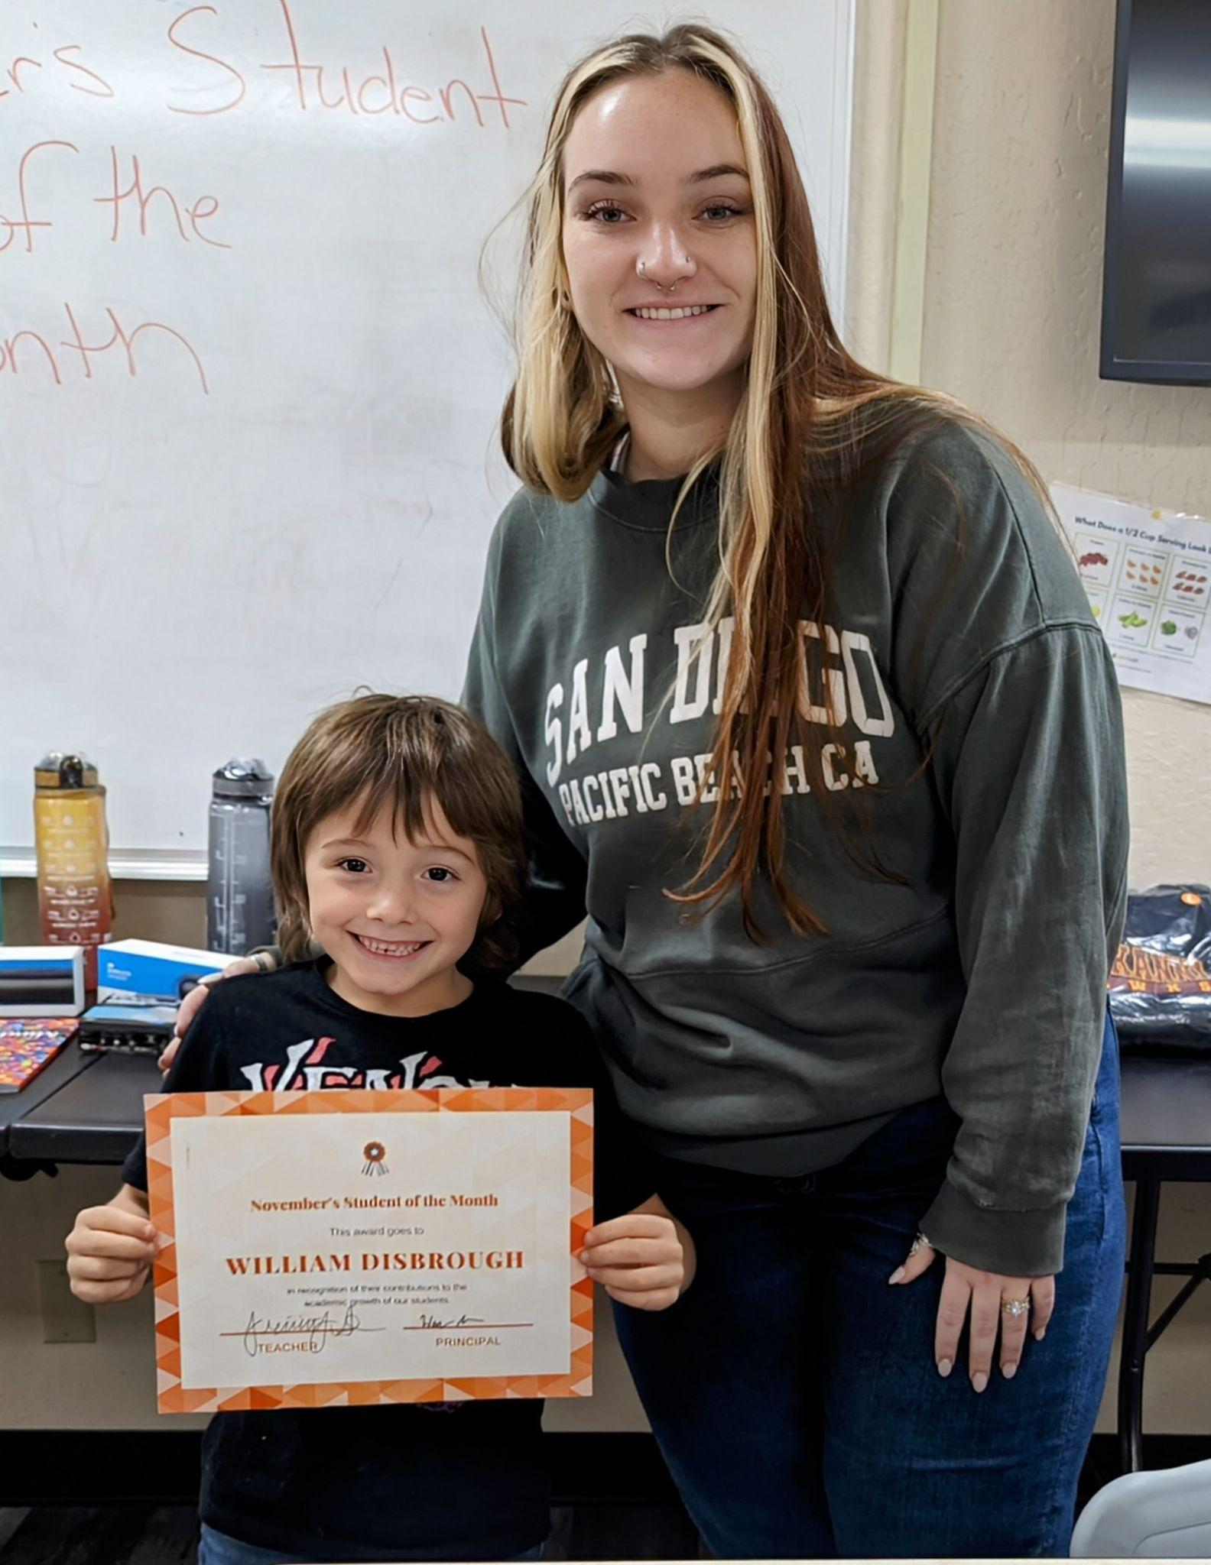
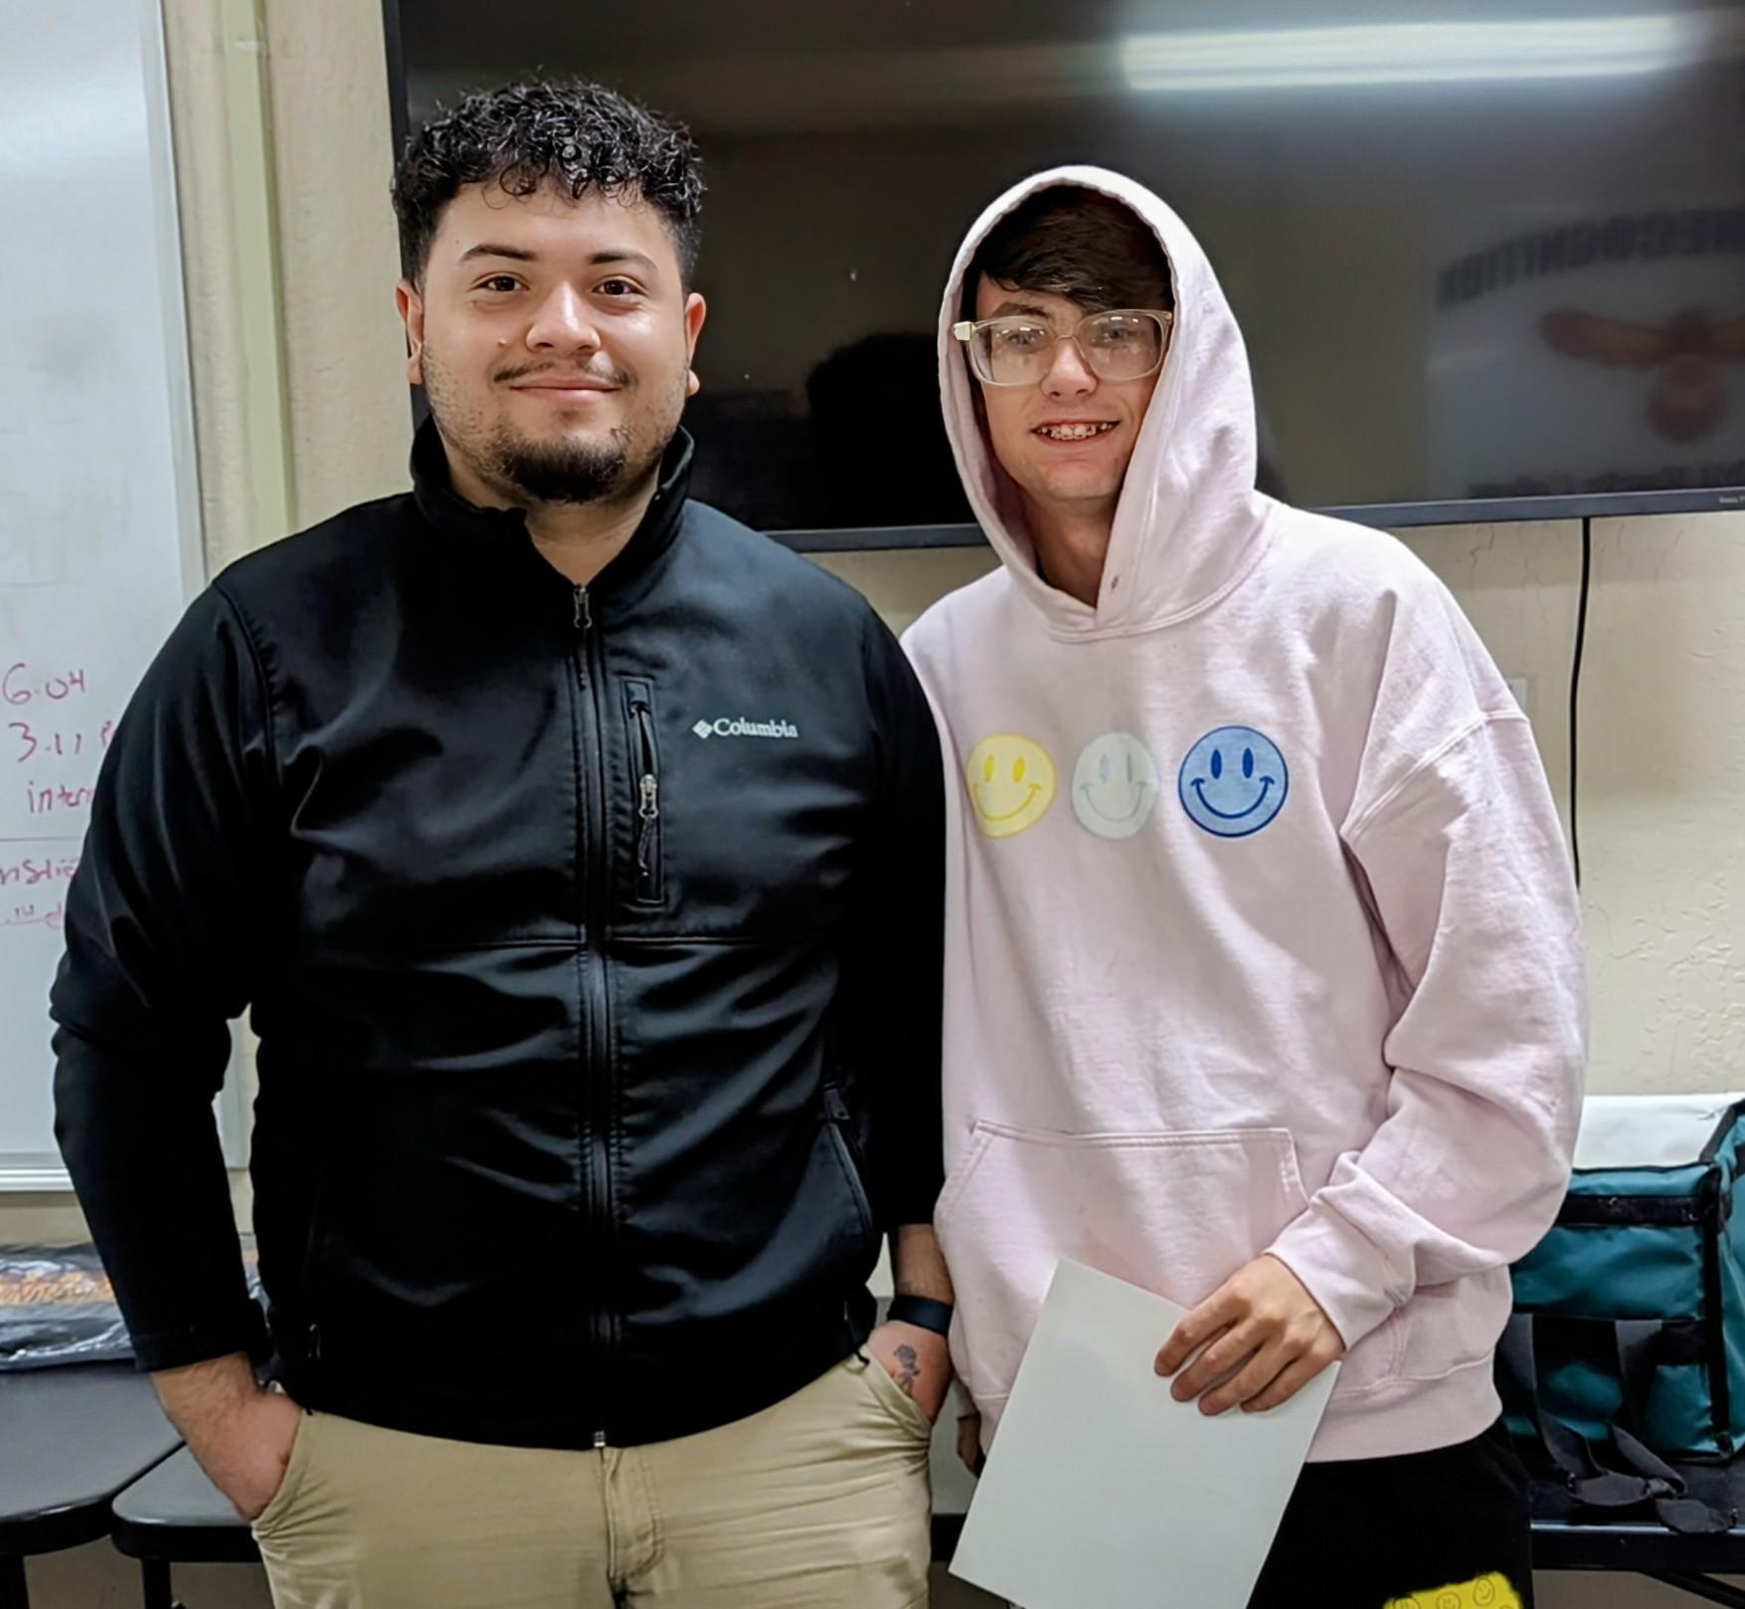
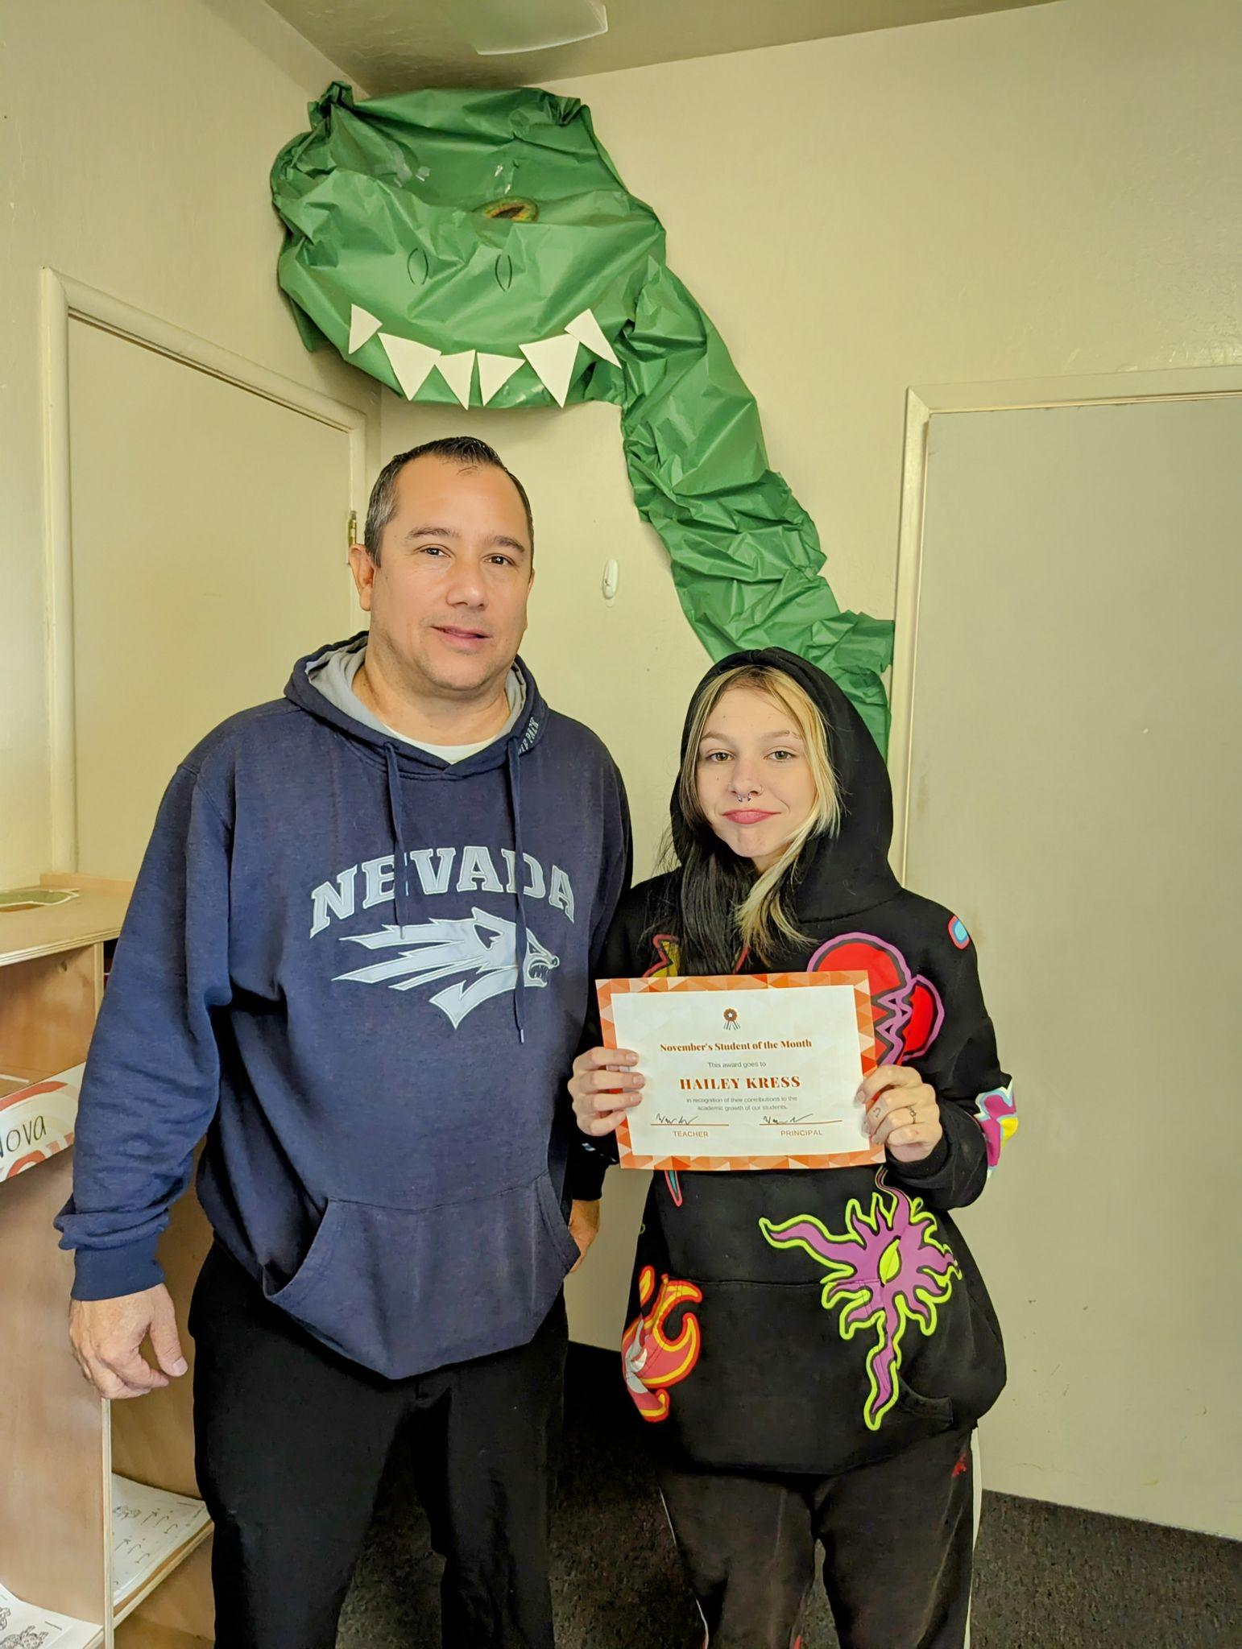
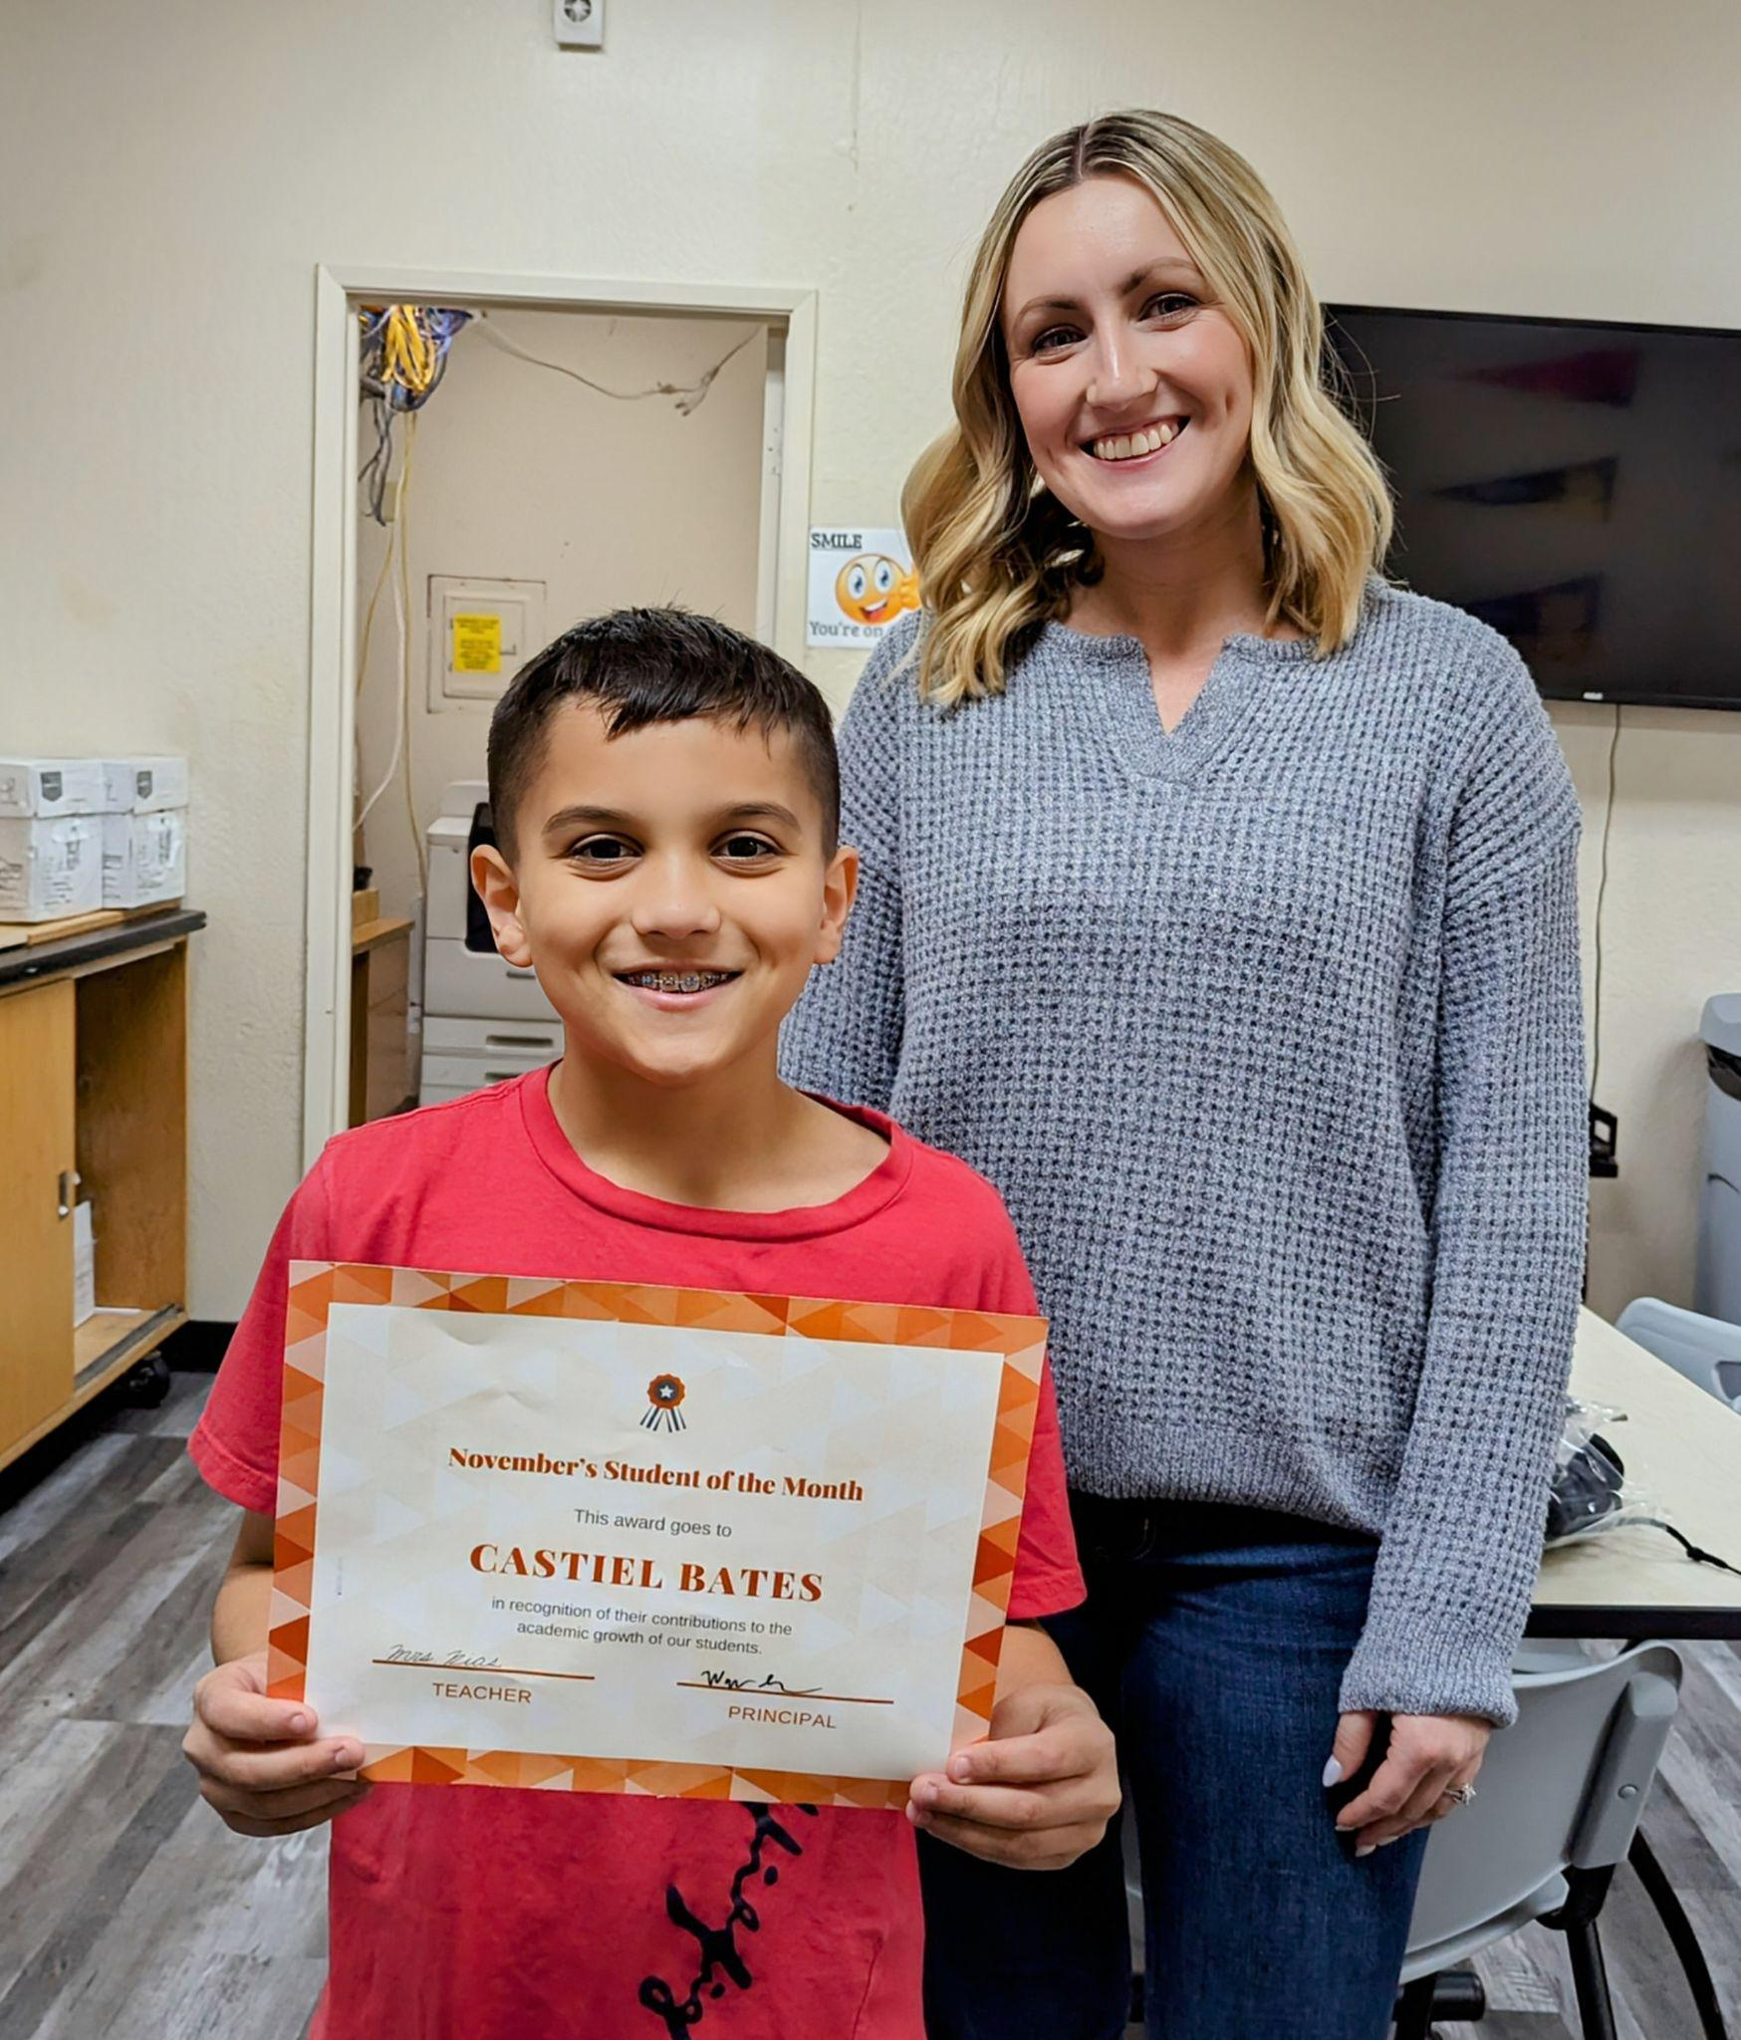
November’s Student of the Month
Hailey Kress
Castiel Bates
William Disbrough
Gavin Hunter

Slide 3
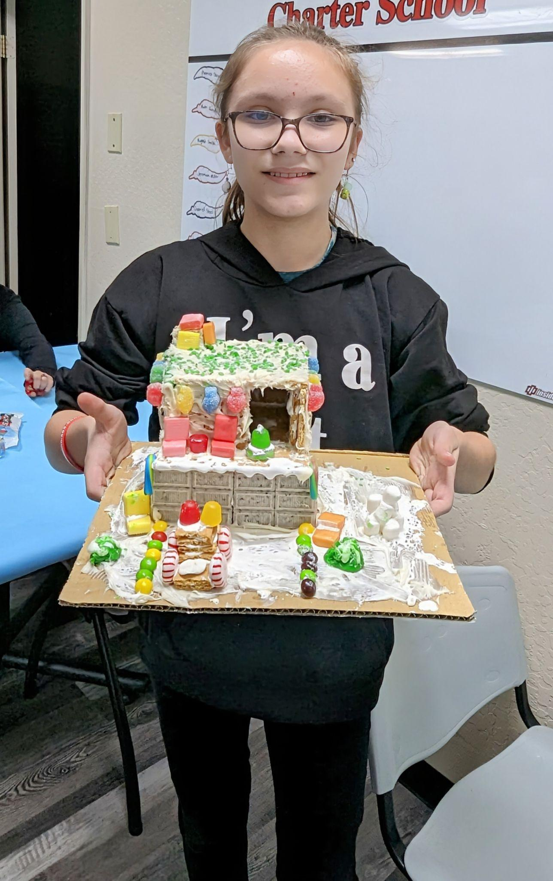
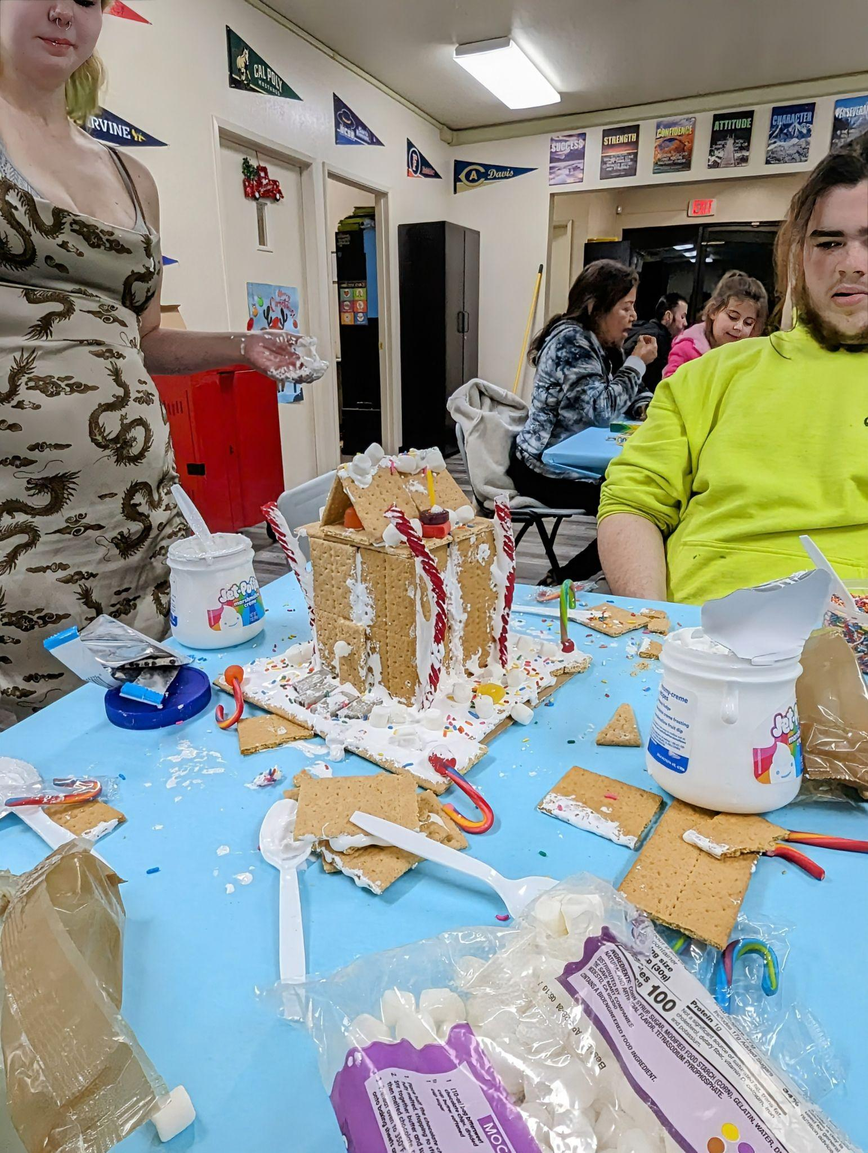
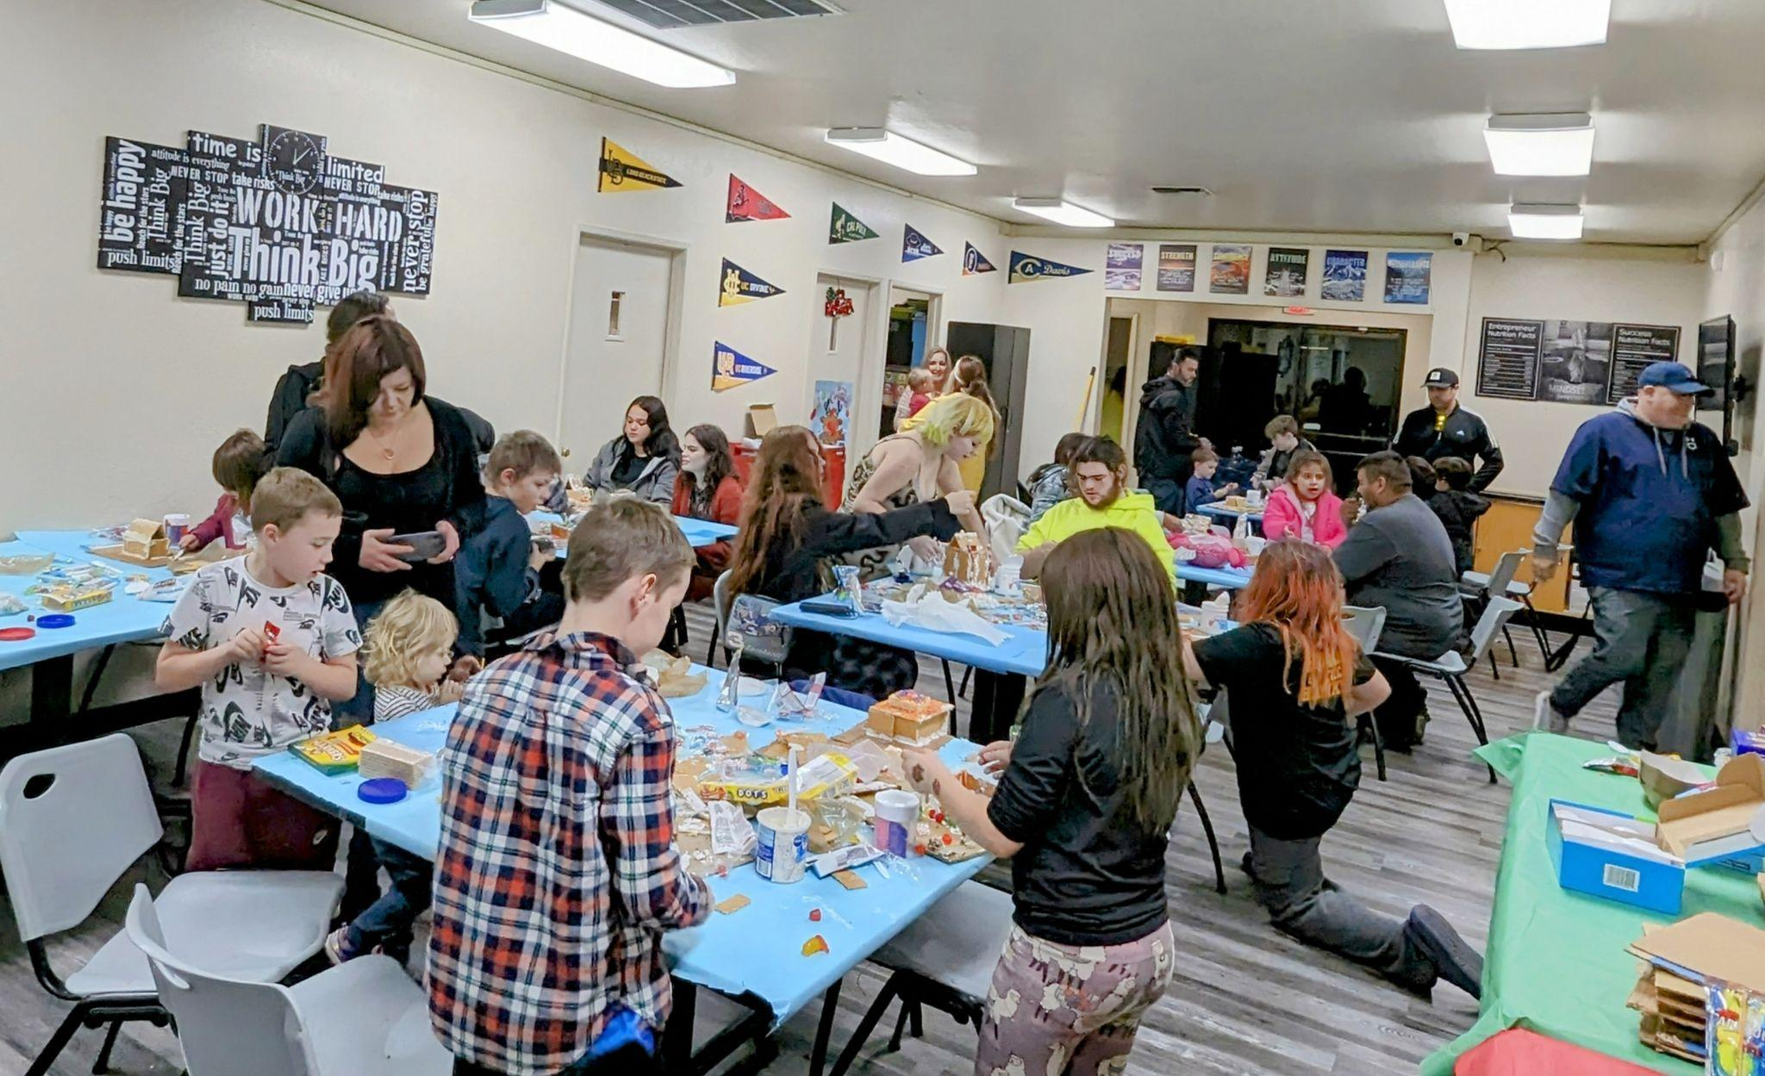
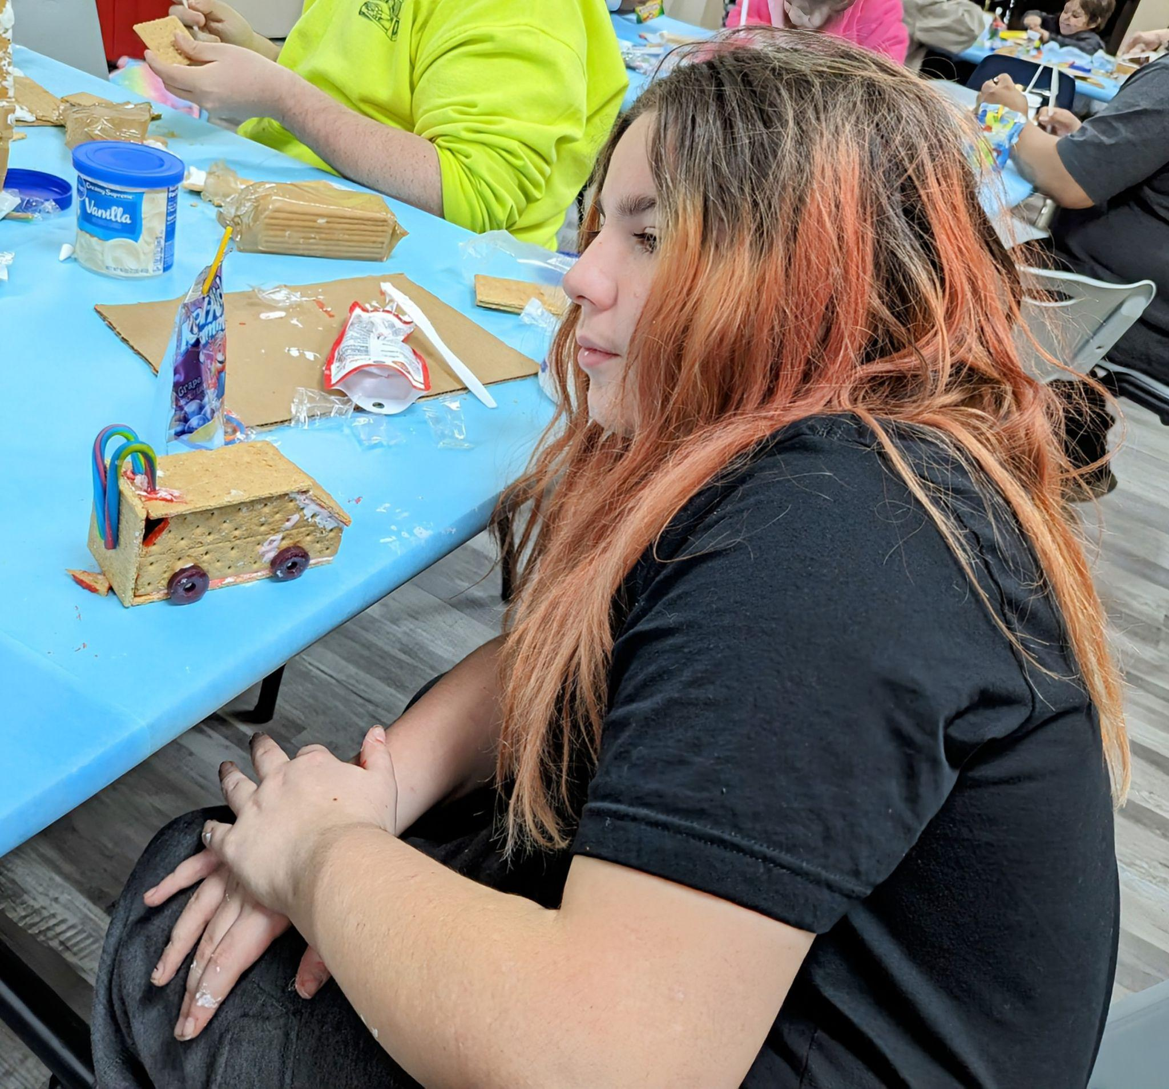
Holiday Party!
Our Holiday Party was held on December 14th and I would like to thank everyone who donated and helped out with the party. Our winner for the gingerbread house making contest was Aubri Humphries. Lillian Weaver came in 2nd and Jayce Arsanis was 3rd. Richard Bargas was recognized for the most artistic and Phoenix Stowell for most creative ideas! Good job everyone.

Slide 4
January Birthdays
Lilly Steele -January 12th
Za’meerah Johnson- January 14th
David Taylor -January 18th

Slide 5
Mark your calendar
January 3rd- Back to school from winter break
January 15th- Martin Luther King Jr Day (NO SCHOOL)
January 3rd,4th and 5th we will not be serving breakfast or lunches.

